Slide 1

Course Outline
What is Virtual Reality?
Scientific and industrial applications of Virtual Reality
The history of (Computer Graphics &) Virtual Reality
(Output channel) Representation of virtual worlds
Visual
Aural
Haptic
(Input channel): Interaction in virtual worlds
Motion tracking
Interacting with virtual objects
Navigation in virtual worlds
Dynamic virtual worlds:
Collision Detection
Modeling of deformable objects
Immersive Visualization
Human Factors
Technology / Hardware
Algorithms / Software

Slide 2
Vision, Audio & Haptics
 | Vision | Audio | Haptics
Human Factors
Anatomy | Human eye | Human ear | Tactile / force receptors
Perception | 3D visual depth cues Photometry | 3D audio depth cues Psychoacoustics
Technology
Compute HW | Graphical Processing Units | Audio boards
Displays | Head-mounted Helmets Room-mounted CAVEs, PowerWalls Stereo techniques Projectors, Screens | Head-mounted Earphones Room-mounted Loudspeakers | Body-mounted devices Grounded devices
Algorithms
Generation | Geometrical modeling | Sound modeling | Force modeling
Rendering | Rendering Pipeline Stereoscopic projections Viewer-centered projections | Binaural synthesis Cross-talk cancellation | Virtual proxy rendering
Global effects | Ray Tracing, Radiosity | Room Acoustics | Multi-contact haptics

Slide 3
Course on Virtual Reality
Vision

Slide 4
Aspects of Vision
Human Factors
Anatomy of the Human Eye
Perception: Depth Cues in Vision, Photometry
Technology
Graphics Hardware
Displays: Projectors, Screens, Brightness, …
Stereo Techniques
Algorithms
Geometrical Modeling
Rendering
Rendering Pipeline
Stereo Projections
Viewer-Centered Projection
Global Illumination: Ray Tracing, Radiosity

Slide 5
Anatomy

Slide 6
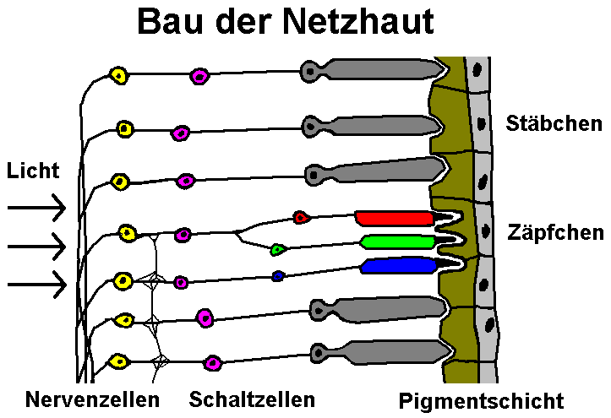
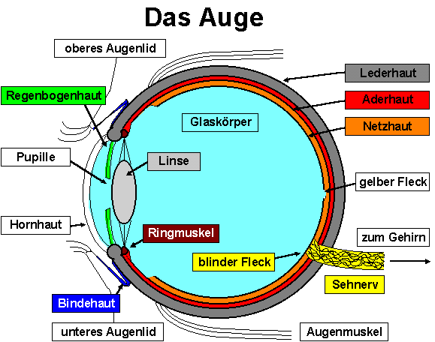
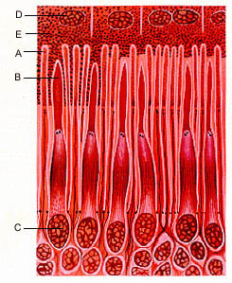
The Human Eye
Quelle: WWW
Notes:
Stäbchen: rod cells
Zäpfchen: cone cells
Regenbogenhaut: iris
Pupille: Pupil
Blende: aperture

Slide 7
Visual Perception

Slide 8
Goal
Exact correspondence of visual perception in the real world and in the virtual world

Slide 9
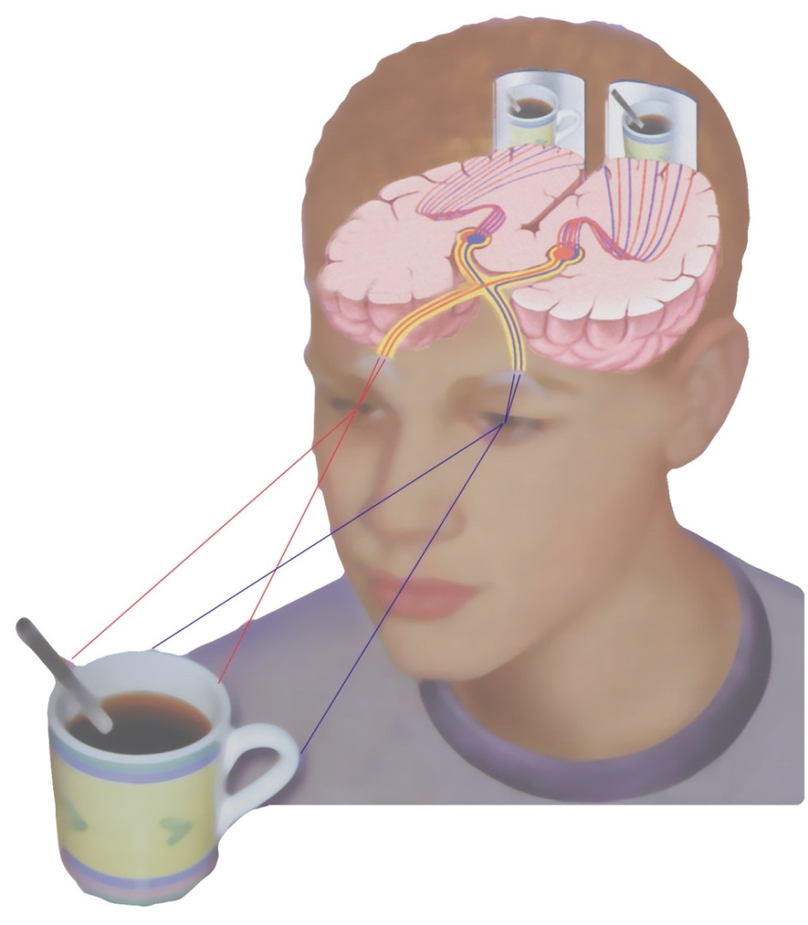
Physiological & Psychological Depth Cues
Traditional CG:
Psychological cues
Perspective shortening
Occlusion of objects
Light and shadows
Texture gradients
Atmospheric perspective
Virtual Reality:
Physiological cues
Stereopsis
Ocular motor factors
Accomodation
Convergence
Motion parallax

Slide 10
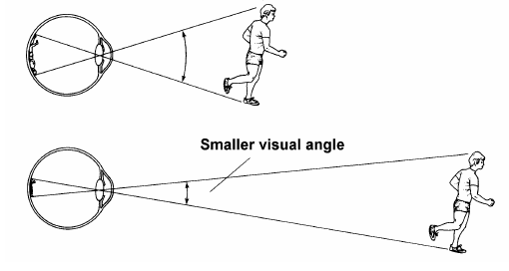
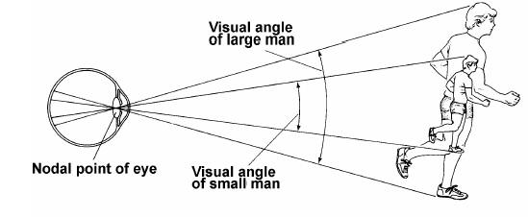
Perspective
Drawing: Goldstein (WWW)

Slide 11
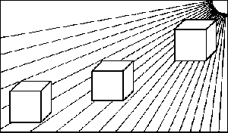
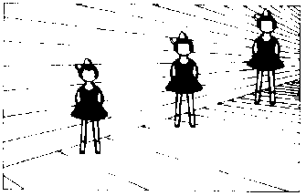
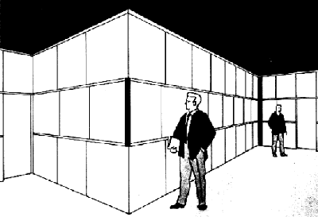
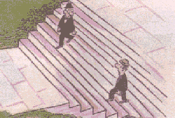
Optical Illusion based on Perspective
Drawing: Anonymous (WWW)

Slide 12
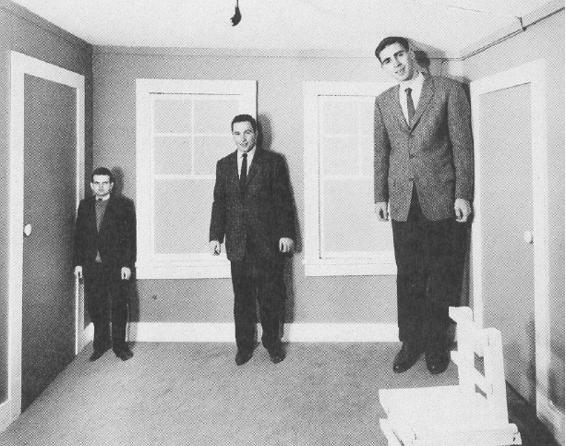
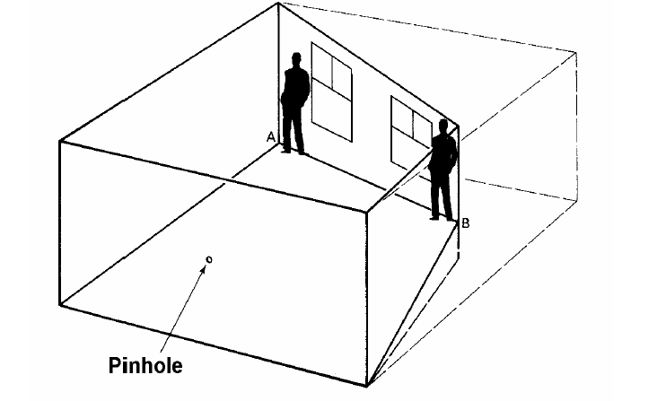
The Ames Room
Pictures: Goldstein, Levine & Shefner (WWW)

Slide 13
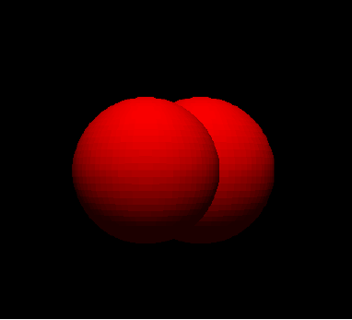
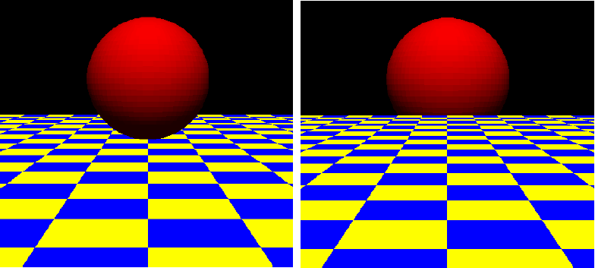
Occlusion
Pictures: Hübner (WWW)

Slide 14
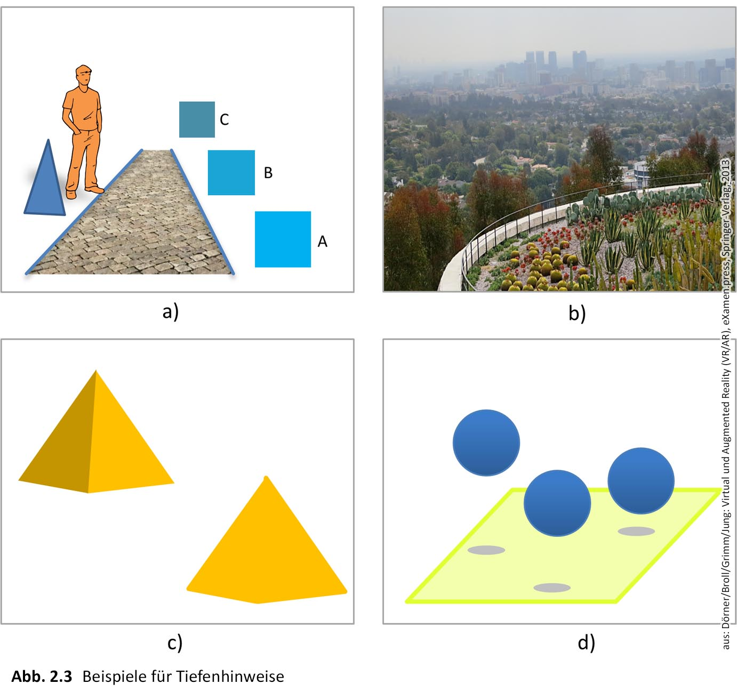
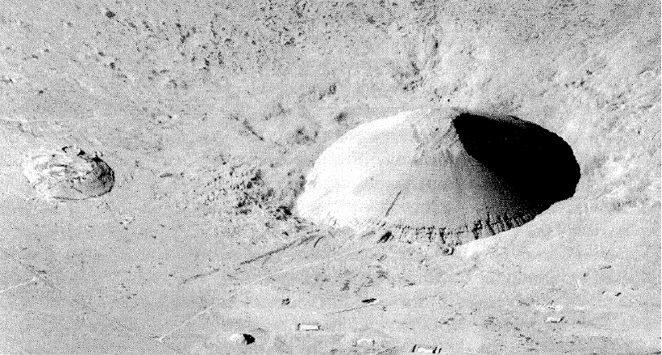
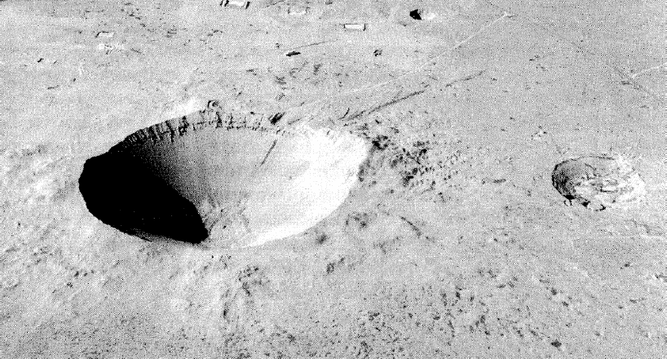
Light & Shadows
Picture: Levine & Shefner (WWW)

Slide 15

Atmospheric Perspective

Slide 16
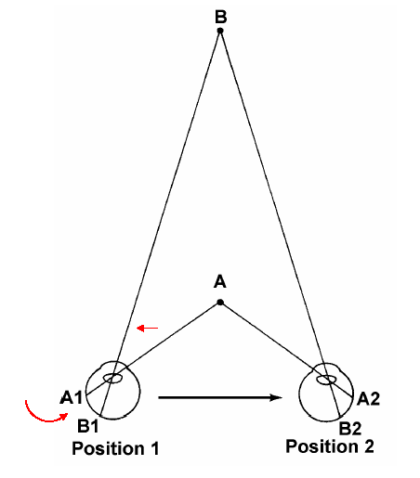
Convergence
Drawing: Goldstein (WWW)

Slide 17
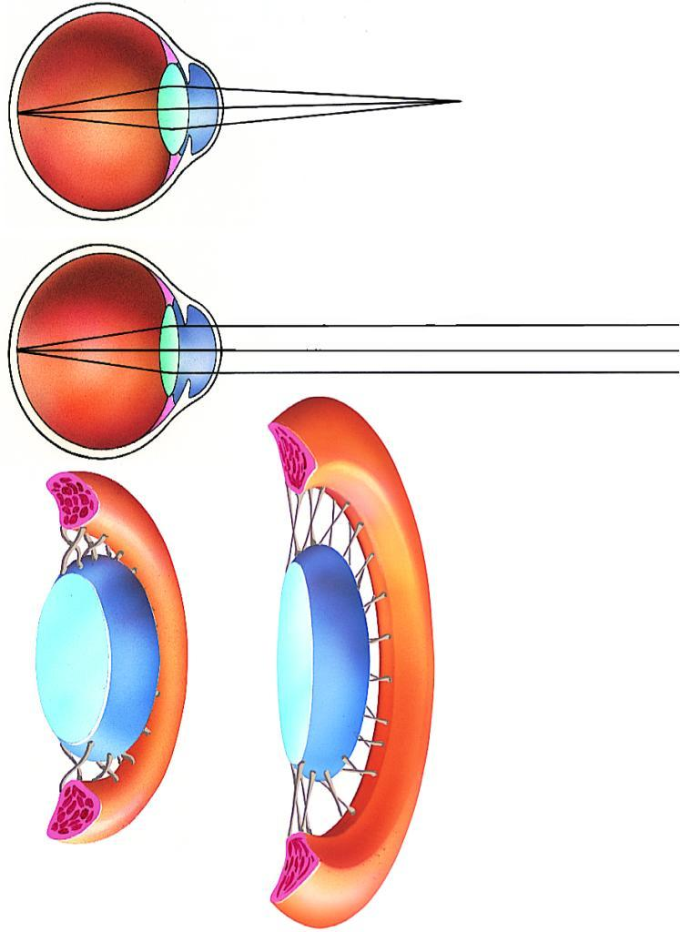
Accomodation
http://www.denstoredanske.dk

Slide 18
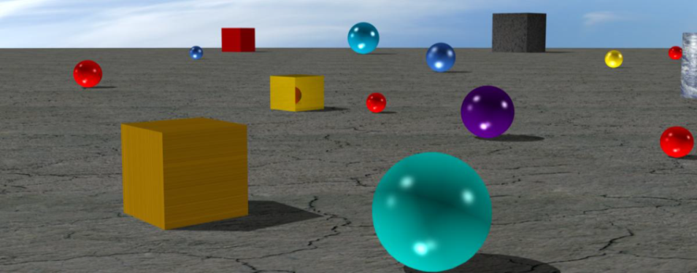
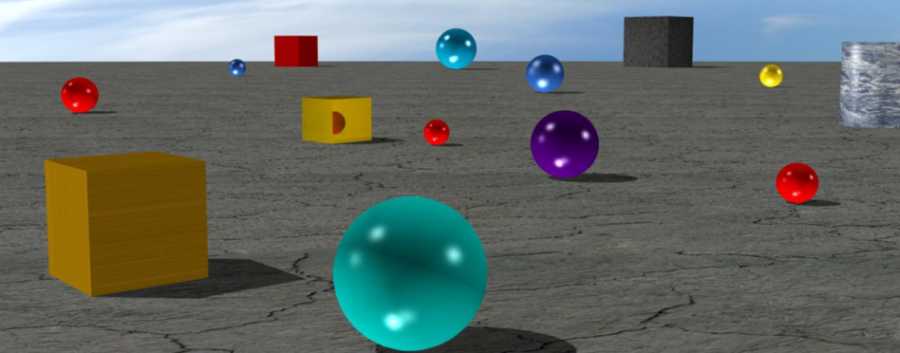
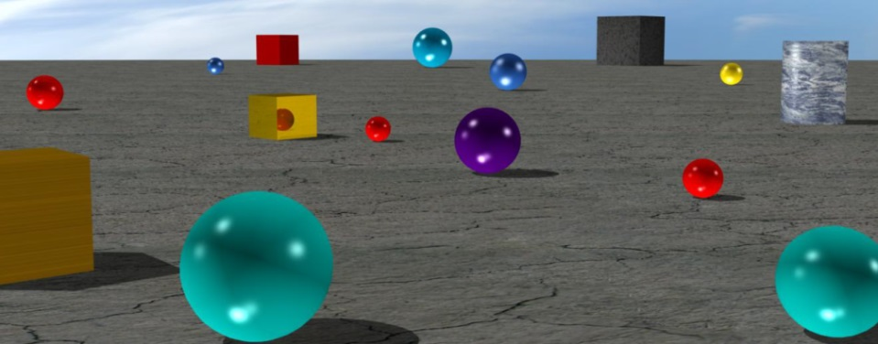
Motion Parallax
Tom Vaughan,
www.cyberlink.com

Slide 19
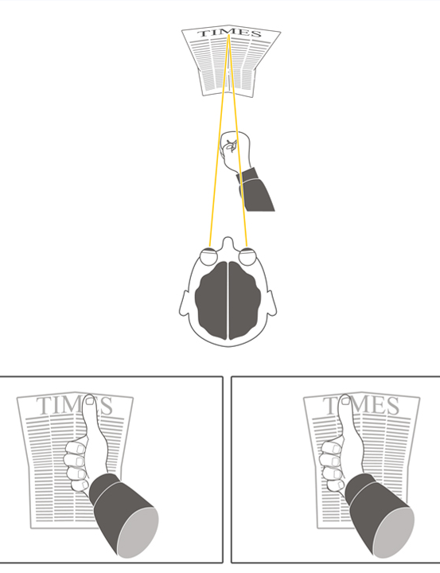
Stereoscopy
http://www.more3d.com/3-D/Stereoskopie.html
Interocular distance (about 6 cm)
Disparity of images projected onto the retina
Processing in the visual cortex of the brain
Works for distances up to 7 m

Slide 20
Field of View
Riecke (2006)
Oval shape
At eye level:
Horizontal: About 90° to both sides
Vertical: About 120° (h 50° and i70°)
FOV center is being perceived by both eyes Stereoscopic field: 100° - 120°

Slide 21
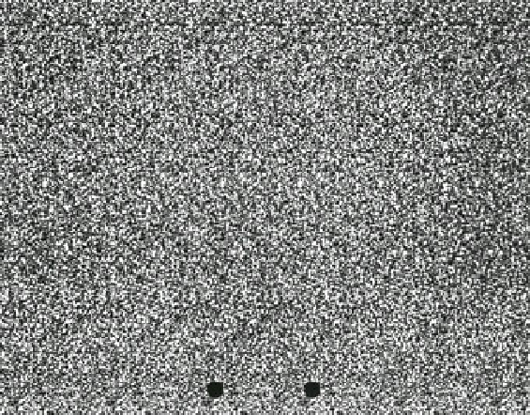
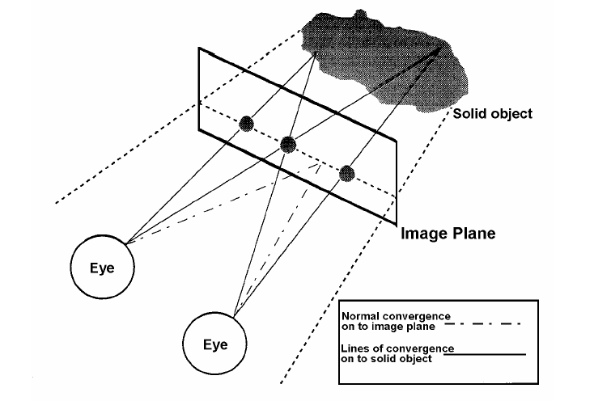
Auto-Stereograms
Drawing: Irtel (WWW)

Slide 22
Auto-Stereograms (cont;-)
Picture: WWW
Look for several seconds at the pic
and you may recognize a giraffe!

